Slide 1
Data Mining:
Concepts and Techniques
(3rd ed.)
— Chapter 1 —
Jiawei Han, Micheline Kamber, and Jian Pei
University of Illinois at Urbana-Champaign &
Simon Fraser University
©2011 Han, Kamber & Pei. All rights reserved.

Slide 2
Chapter 1. Introduction
Why Data Mining?
What Is Data Mining?
A Multi-Dimensional View of Data Mining
What Kind of Data Can Be Mined?
What Kinds of Patterns Can Be Mined?
What Technology Are Used?
What Kind of Applications Are Targeted?
Major Issues in Data Mining
A Brief History of Data Mining and Data Mining Society
Summary

Slide 3
Why Data Mining?
The Explosive Growth of Data: from terabytes to petabytes
  Data collection and data availability
    Automated data collection tools, database systems, Web, computerized society
  Major sources of abundant data
    Business: Web, e-commerce, transactions, stocks, …
    Science: Remote sensing, bioinformatics, scientific simulation, …
    Society and everyone: news, digital cameras, YouTube
We are drowning in data, but starving for knowledge!
“Necessity is the mother of invention”—Data mining—Automated analysis of massive data sets

Slide 4



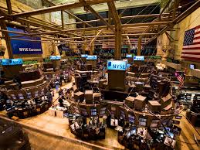

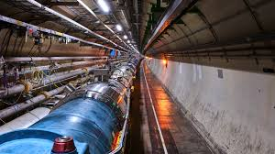
Why Mine Data?

Slide 5

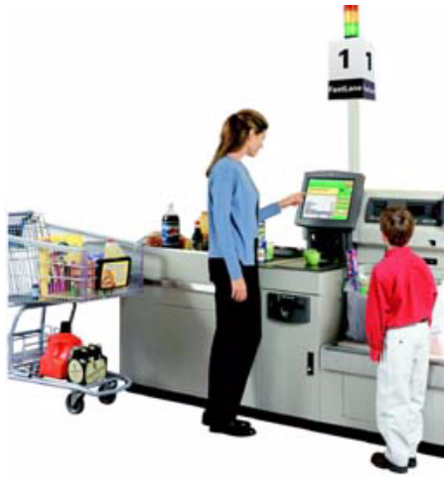


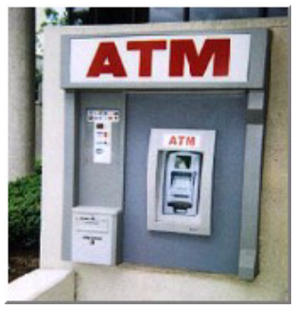
Why Mine Data? Commercial Viewpoint
Lots of data is being collected
and warehoused
  Web data, e-commerce
  purchases at department/
  grocery stores
  Bank/Credit Card
  transactions
Computers have become cheaper and more powerful
Competitive Pressure is Strong
  Provide better, customized services for an edge (e.g. in Customer Relationship Management)

Slide 6
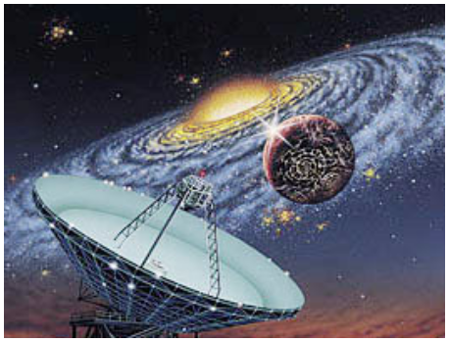
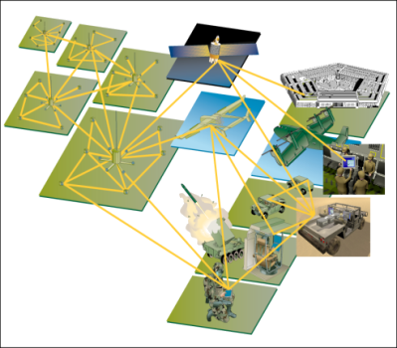
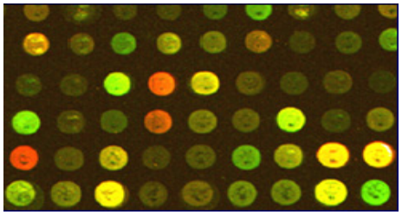
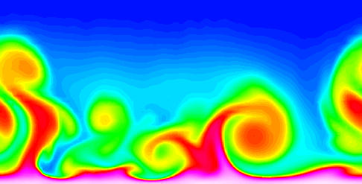
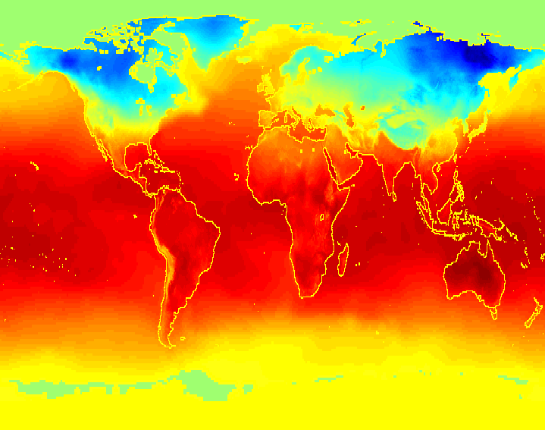
Why Mine Data? Scientific Viewpoint
Data collected and stored at
enormous speeds (GB/hour)
  remote sensors on a satellite
  telescopes scanning the skies
  The Large Hadron Collider generates 40 TB/sec
  scientific simulations
  generating terabytes of data
Traditional techniques infeasible for raw data
Data mining may help scientists
  in classifying and segmenting data
  in Hypothesis Formation

Slide 7
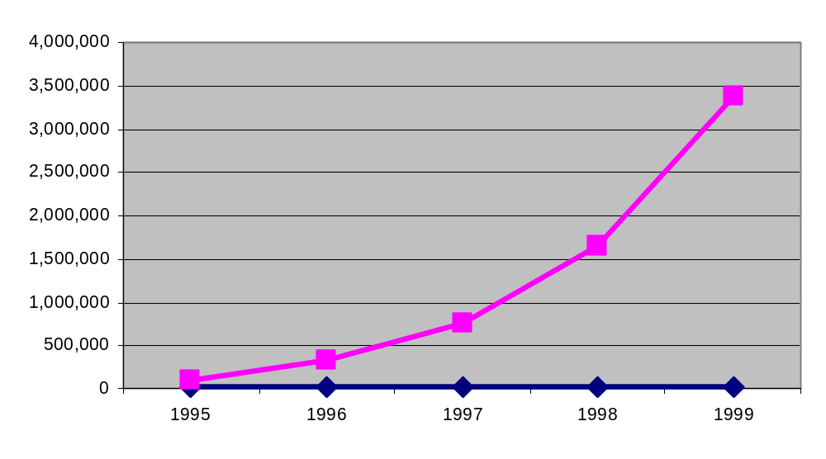
Mining Large Data Sets - Motivation
There is often information “hidden” in the data that is
not readily evident
Human analysts may take weeks to discover useful information
Much of the data is never analyzed at all
The Data Gap
Total new disk (TB) since 1995
Number of analysts

Slide 8
Evolution of Sciences
Before 1600, empirical science
1600-1950s, theoretical science
  Each discipline has grown a theoretical component. Theoretical models often motivate experiments and generalize our understanding.
1950s-1990s, computational science
  Over the last 50 years, most disciplines have grown a third, computational branch (e.g. empirical, theoretical, and computational ecology, or physics, or linguistics.)
  Computational Science traditionally meant simulation. It grew out of our inability to find closed-form solutions for complex mathematical models.
1990-now, data science
  The flood of data from new scientific instruments and simulations
  The ability to economically store and manage petabytes of data online
  The Internet and computing Grid that makes all these archives universally accessible
  Scientific info. management, acquisition, organization, query, and visualization tasks scale almost linearly with data volumes. Data mining is a major new challenge!
Jim Gray and Alex Szalay, The World Wide Telescope: An Archetype for Online Science, Comm. ACM, 45(11): 50-54, Nov. 2002

Slide 9
Evolution of Database Technology
1960s:
  Data collection, database creation, IMS and network DBMS
1970s:
  Relational data model, relational DBMS implementation
1980s:
  RDBMS, advanced data models (extended-relational, OO, deductive, etc.)
  Application-oriented DBMS (spatial, scientific, engineering, etc.)
1990s:
  Data mining, data warehousing, multimedia databases, and Web databases
2000s
  Stream data management and mining
  Data mining and its applications
  Web technology (XML, data integration) and global information systems
Notes:
Two slides should be added after this one
1. Evolution of machine learning
2. Evolution of statistics methods

Slide 10
Chapter 1. Introduction
Why Data Mining?
What Is Data Mining?
A Multi-Dimensional View of Data Mining
What Kind of Data Can Be Mined?
What Kinds of Patterns Can Be Mined?
What Technology Are Used?
What Kind of Applications Are Targeted?
Major Issues in Data Mining
A Brief History of Data Mining and Data Mining Society
Summary

Slide 11


What Is Data Mining?
Data mining (knowledge discovery from data)
  Extraction of interesting (non-trivial, implicit, previously unknown and potentially useful) patterns or knowledge from huge amount of data
  Data mining: a misnomer?
Alternative names
  Knowledge discovery (mining) in databases (KDD), knowledge extraction, data/pattern analysis, data archeology, data dredging, information harvesting, business intelligence, etc.
Watch out: Is everything “data mining”?
  Simple search and query processing
  (Deductive) expert systems

Slide 12
Knowledge Discovery (KDD) Process
Knowledge
This is a view from typical database systems and data warehousing communities
Data mining plays an essential role in the knowledge discovery process
Pattern Evaluation
Data Mining
Task-relevant Data
Data Warehouse
Selection
Data Cleaning
Data Integration
Databases

Slide 13
Origins of Data Mining
Draws ideas from machine learning/AI, pattern recognition, statistics, and database systems
Traditional Techniques
may be unsuitable due to
  Enormity of data
  High dimensionality
  of data
  Heterogeneous,
  distributed nature
  of data
Statistics/
AI
Machine Learning/
Pattern
Recognition
Data Mining
Database systems

Slide 14
Data Mining Tasks
Prediction Methods
  Use some variables to predict unknown or future values of other variables.
Description Methods
  Find human-interpretable patterns that describe the data.

Slide 15
Chapter 1. Introduction
Why Data Mining?
What Is Data Mining?
A Multi-Dimensional View of Data Mining
What Kind of Data Can Be Mined?
What Kinds of Patterns Can Be Mined?
What Technology Are Used?
What Kind of Applications Are Targeted?
Major Issues in Data Mining
A Brief History of Data Mining and Data Mining Society
Summary

Slide 16
Multi-Dimensional View of Data Mining
Data to be mined
  Database data (extended-relational, object-oriented, heterogeneous, legacy), data warehouse, transactional data, stream, spatiotemporal, time-series, sequence, text and web, multi-media, graphs & social and information networks
Knowledge to be mined (or: Data mining functions)
  Characterization, discrimination, association, classification, clustering, trend/deviation, outlier analysis, etc.
  Descriptive vs. predictive data mining
  Multiple/integrated functions and mining at multiple levels
Techniques utilized
  Data-intensive, data warehouse (OLAP), machine learning, statistics, pattern recognition, visualization, high-performance, etc.
Applications adapted
  Retail, telecommunication, banking, fraud analysis, bio-data mining, stock market analysis, text mining, Web mining, etc.

Slide 17
Data Mining Tasks
Prediction Methods
  Use some variables to predict unknown or future values of other variables.
Description Methods
  Find human-interpretable patterns that describe the data.
From [Fayyad, et.al.] Advances in Knowledge Discovery and Data Mining, 1996
01/17/2018
Introduction to Data Mining, 2nd Edition

Slide 18
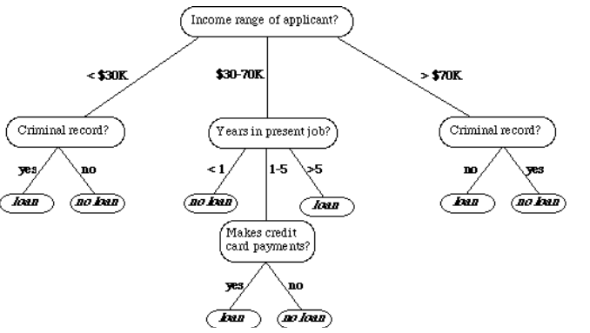
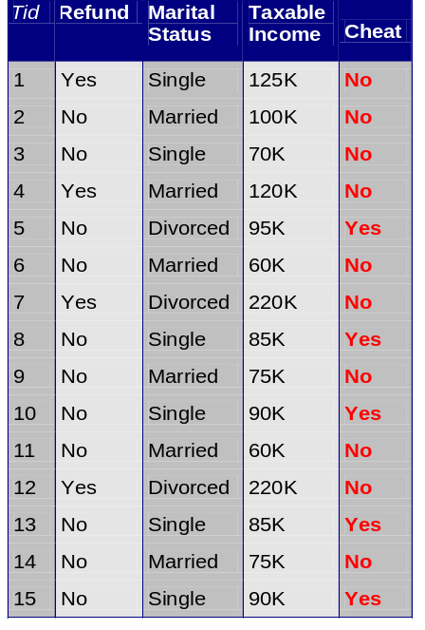



Data Mining Tasks …
Data
Clustering
Predictive Modeling
Association
Rules
Anomaly
Detection
Milk
01/17/2018
Introduction to Data Mining, 2nd Edition

Slide 19
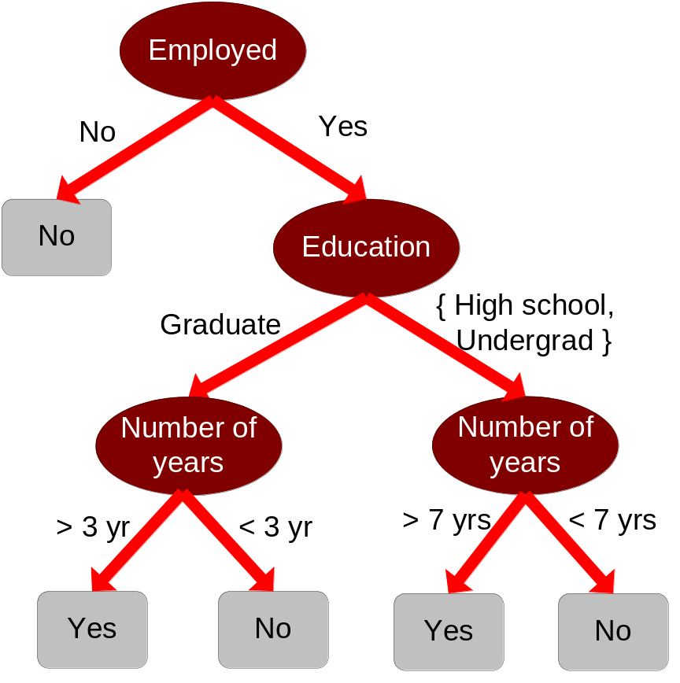
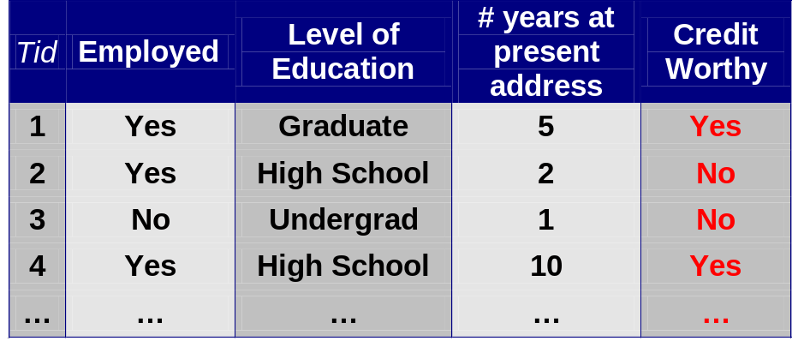
Predictive Modeling: Classification
Find a model for class attribute as a function of the values of other attributes
Model for predicting credit worthiness
Class
01/17/2018
Introduction to Data Mining, 2nd Edition

Slide 20
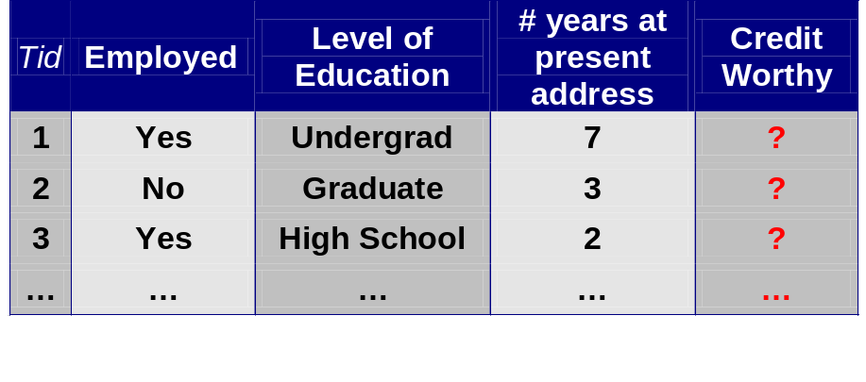
Classification Example
categorical
quantitative
categorical
class
Test
Set
Learn
Classifier
Training
Set
Model
01/17/2018
Introduction to Data Mining, 2nd Edition

Slide 21
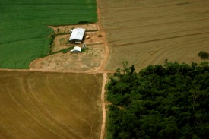

Examples of Classification Task
Classifying credit card transactions
as legitimate or fraudulent
Classifying land covers (water bodies, urban areas, forests, etc.) using satellite data
Categorizing news stories as finance,
weather, entertainment, sports, etc
Identifying intruders in the cyberspace
Predicting tumor cells as benign or malignant
Classifying secondary structures of protein
as alpha-helix, beta-sheet, or random coil
01/17/2018
Introduction to Data Mining, 2nd Edition

Slide 22
Classification: Application 1
Fraud Detection
  Goal: Predict fraudulent cases in credit card transactions.
  Approach:
    Use credit card transactions and the information on its account-holder as attributes.
      When does a customer buy, what does he buy, how often he pays on time, etc
    Label past transactions as fraud or fair transactions. This forms the class attribute.
    Learn a model for the class of the transactions.
    Use this model to detect fraud by observing credit card transactions on an account.
01/17/2018
Introduction to Data Mining, 2nd Edition

Slide 23
Classification: Application 2
Churn prediction for telephone customers
  Goal: To predict whether a customer is likely to be lost to a competitor.
  Approach:
    Use detailed record of transactions with each of the past and present customers, to find attributes.
      How often the customer calls, where he calls, what time-of-the day he calls most, his financial status, marital status, etc.
    Label the customers as loyal or disloyal.
    Find a model for loyalty.
From [Berry & Linoff] Data Mining Techniques, 1997
01/17/2018
Introduction to Data Mining, 2nd Edition

Slide 24
Classification: Application 3
Sky Survey Cataloging
  Goal: To predict class (star or galaxy) of sky objects, especially visually faint ones, based on the telescopic survey images (from Palomar Observatory).
      3000 images with 23,040 x 23,040 pixels per image.
  Approach:
    Segment the image.
    Measure image attributes (features) - 40 of them per object.
    Model the class based on these features.
    Success Story: Could find 16 new high red-shift quasars, some of the farthest objects that are difficult to find!
From [Fayyad, et.al.] Advances in Knowledge Discovery and Data Mining, 1996
01/17/2018
Introduction to Data Mining, 2nd Edition

Slide 25



Classifying Galaxies
Courtesy: http://aps.umn.edu
Early
Class:
Stages of Formation
Attributes:
Image features,
Characteristics of light waves received, etc.
Intermediate
Late
Data Size:
72 million stars, 20 million galaxies
Object Catalog: 9 GB
Image Database: 150 GB
01/17/2018
Introduction to Data Mining, 2nd Edition

Slide 26
Regression
Predict a value of a given continuous valued variable based on the values of other variables, assuming a linear or nonlinear model of dependency.
Extensively studied in statistics, neural network fields.
Examples:
  Predicting sales amounts of new product based on advetising expenditure.
  Predicting wind velocities as a function of temperature, humidity, air pressure, etc.
  Time series prediction of stock market indices.
01/17/2018
Introduction to Data Mining, 2nd Edition

Slide 27
What is Cluster Analysis?
Cluster: a collection of data objects
  Similar to one another within the same cluster
  Dissimilar to the objects in other clusters
Cluster analysis
  Finding similarities between data according to the characteristics found in the data and grouping similar data objects into clusters
Unsupervised learning: no predefined classes
Typical applications
  As a stand-alone tool to get insight into data distribution
  As a preprocessing step for other algorithms

Slide 28
Clustering
Finding groups of objects such that the objects in a group will be similar (or related) to one another and different from (or unrelated to) the objects in other groups
Inter-cluster distances are maximized
Intra-cluster distances are minimized
01/17/2018
Introduction to Data Mining, 2nd Edition

Slide 29
Quality: What Is Good Clustering?
A good clustering method will produce high quality clusters with
  high intra-class similarity
  low inter-class similarity
The quality of a clustering result depends on both the similarity measure used by the method and its implementation
The quality of a clustering method is also measured by its ability to discover some or all of the hidden patterns

Slide 30
Examples of Clustering Applications
Marketing: Help marketers discover distinct groups in their customer bases, and then use this knowledge to develop targeted marketing programs
Land use: Identification of areas of similar land use in an earth observation database
Insurance: Identifying groups of motor insurance policy holders with a high average claim cost
City-planning: Identifying groups of houses according to their house type, value, and geographical location
Earth-quake studies: Observed earth quake epicenters should be clustered along continent faults

Slide 31
Clustering: Application 1
Market Segmentation:
  Goal: subdivide a market into distinct subsets of customers where any subset may conceivably be selected as a market target to be reached with a distinct marketing mix.
  Approach:
    Collect different attributes of customers based on their geographical and lifestyle related information.
    Find clusters of similar customers.
    Measure the clustering quality by observing buying patterns of customers in same cluster vs. those from different clusters.

Slide 32
Clustering: Application 2
Document Clustering:
  Goal: To find groups of documents that are similar to each other based on the important terms appearing in them.
  Approach: To identify frequently occurring terms in each document. Form a similarity measure based on the frequencies of different terms. Use it to cluster.
  Gain: Information Retrieval can utilize the clusters to relate a new document or search term to clustered documents.

Slide 33
Measure the Quality of Clustering
Dissimilarity/Similarity metric: Similarity is expressed in terms of a distance function, typically metric: d(i, j)
There is a separate “quality” function that measures the “goodness” of a cluster.
The definitions of distance functions are usually very different for interval-scaled, boolean, categorical, ordinal ratio, and vector variables.
Weights should be associated with different variables based on applications and data semantics.
It is hard to define “similar enough” or “good enough”
  the answer is typically highly subjective.

Slide 34

Association Rule Discovery: Definition
Given a set of records each of which contain some number of items from a given collection
  Produce dependency rules which will predict occurrence of an item based on occurrences of other items.
Rules Discovered:
{Milk} --> {Coke}
{Diaper, Milk} --> {Beer}
01/17/2018
Introduction to Data Mining, 2nd Edition

Slide 35
Association Rule: Basic Concepts
Given: (1) database of transactions, (2) each transaction is a list of items (purchased by a customer in a visit)
Find: all rules that correlate the presence of one set of items with that of another set of items
  E.g., 98% of people who purchase tires and auto accessories also get automotive services done
Applications
  * ⇒ Maintenance Agreement (What the store should do to boost Maintenance Agreement sales)
  Home Electronics ⇒ * (What other products should the store stocks up?)
  Attached mailing in direct marketing
  Detecting “ping-pong”ing of patients, faulty “collisions”

Slide 36
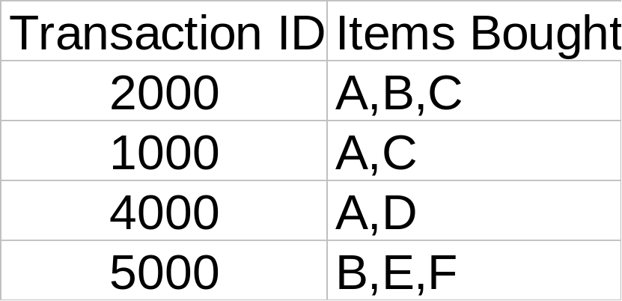
Rule Measures: Support and Confidence
Customer
buys both
Customer
buys diaper
Find all the rules X & Y ⇒ Z with minimum confidence and support
  support, s, probability that a transaction contains {X  Y  Z}
  confidence, c, conditional probability that a transaction having {X  Y} also contains Z
Customer
buys beer
Let minimum support 50%, and minimum confidence 50%, we have
  A ⇒ C (50%, 66.6%)
  C ⇒ A (50%, 100%)

Slide 37
Association Rule Discovery: Application 1
Marketing and Sales Promotion:
  Let the rule discovered be
  {Bagels, … } --> {Potato Chips}
  Potato Chips as consequent => Can be used to determine what should be done to boost its sales.
  Bagels in the antecedent => Can be used to see which products would be affected if the store discontinues selling bagels.
  Bagels in antecedent and Potato chips in consequent => Can be used to see what products should be sold with Bagels to promote sale of Potato chips!

Slide 38
Association Rule Discovery: Application 2
Supermarket shelf management.
  Goal: To identify items that are bought together by sufficiently many customers.
  Approach: Process the point-of-sale data collected with barcode scanners to find dependencies among items.
  A classic rule --
    If a customer buys diaper and milk, then he is very likely to buy beer.
    So, don’t be surprised if you find six-packs stacked next to diapers!

Slide 39
Association Rule Discovery: Application 3
Inventory Management:
  Goal: A consumer appliance repair company wants to anticipate the nature of repairs on its consumer products and keep the service vehicles equipped with right parts to reduce on number of visits to consumer households.
  Approach: Process the data on tools and parts required in previous repairs at different consumer locations and discover the co-occurrence patterns.

Slide 40
Association Analysis: Applications
Market-basket analysis
  Rules are used for sales promotion, shelf management, and inventory management
Telecommunication alarm diagnosis
  Rules are used to find combination of alarms that occur together frequently in the same time period
Medical Informatics
  Rules are used to find combination of patient symptoms and test results associated with certain diseases
01/17/2018
Introduction to Data Mining, 2nd Edition

Slide 41
Data Mining Function: (5) Outlier Analysis
Outlier analysis
  Outlier: A data object that does not comply with the general behavior of the data
  Noise or exception? ― One person’s garbage could be another person’s treasure
  Methods: by product of clustering or regression analysis, …
  Useful in fraud detection, rare events analysis

Slide 42
Motivating Challenges
Scalability
High Dimensionality
Heterogeneous and Complex Data
Mining various and new kinds of knowledge
01/17/2018
Introduction to Data Mining, 2nd Edition

Slide 43
Data Mining in Business Intelligence
Increasing potential
to support
business decisions
End User
Decision Making
Data Presentation
Business
Analyst
Visualization Techniques
Data Mining
Data
Analyst
Information Discovery
Data Exploration
Statistical Summary, Querying, and Reporting
Data Preprocessing/Integration, Data Warehouses
Data Sources
DBA
Paper, Files, Web documents, Scientific experiments, Database Systems

Slide 44
Example: Mining vs. Data Exploration
Business intelligence view
  Warehouse, data cube, reporting but not much mining
Business objects vs. data mining tools
Supply chain example: tools
Data presentation
Exploration

Slide 45
KDD Process: A Typical View from ML and Statistics
Pattern
Information
Knowledge
Input Data
Data Pre-Processing
Data Mining
Post-Processing
Data integration
Normalization
Feature selection
Dimension reduction
Pattern discovery
Association & correlation
Classification
Clustering
Outlier analysis
… … … …
Pattern evaluation
Pattern selection
Pattern interpretation
Pattern visualization
This is a view from typical machine learning and statistics communities

Slide 46
Example: Medical Data Mining
Health care & medical data mining – often adopted such a view in statistics and machine learning
Preprocessing of the data (including feature extraction and dimension reduction)
Classification or/and clustering processes
Post-processing for presentation

